Slide 1
Containers Without Orchestration
AWS Moderization Team

Slide 2

Why Containers?
Speed
Efficiency
Easier packaging
Less risky deployments
Better Development experience
Microservices
Photo & Licence
Notes:
There are a number of reasons why many of our customers are moving to containers:
Much faster launch times help to scale, deploy and heal your applications faster
Binpacking many together on each EC2 instance can allow you to more fully utilize your instances and save on cost
Easier packaging and deployment of their applications can lead to a better development experience
And, because a container should run the same way on a laptop as in production, there is a decreased risk of deployment or change not working
The real driver in most organizations, though, is microservices – many more services to run requires a platform to cater for that.

Slide 3
Challenges of Containers at Scale
More transient
More distributed and complex
Networking
Scheduling / Resource Management
Less isolated (containers can share a kernel)
Notes:
Containers can help solve many of the microservices problems but running them in production and at scale has its own challenges though.
They can come and go in seconds so managing and monitoring them can be problematic
The container clusters to run them effectively are complex distributed systems in their own right
And the efficiencies of them come from containers sharing a kernel and relying on the kernel’s security features for their isolation
There are solutions to all of these problems though and AWS can help.

Slide 4
AWS Container Strategy
Notes:
And, Because this is an AWS container talk I think it is important to start with our current container landscape and strategy.

Slide 5



We Give You The Power To Choose:
ECS
EKS
1. Choose your
orchestration tool
2. Choose your
launch type
EC2
Fargate
EC2
Fargate
Notes:
That strategy is one of giving our customers choice – between two great orchestration tools in our Elastic Container Service and Kubernetes and between two launch types for each of them. There is the traditional EC2 launch type where customers bring the instances to run their containers and get a bit more control of the type and OS of those instances or our new Fargate type where we take care of all that for you.

Slide 6

What is Kubernetes?
Open source container management platform
Helps you run containers at scale
Gives you primitives for building modern applications
Notes:
The first thing we need to do is introduce Kubernetes. Kubernetes is a rapidly moving open source project with a lot of enthusiasm around it. It’s a platform for running microservices at scale. Kubernetes can be run anywhere. Kubernetes is an open-source container management platform. It’s built to help you run your containers at scale and comes equipped with features and functions to build proper distributed applications using the 12-factor app pattern.

Slide 7
Cloud-native applications
MICROSERVICE TOOLING
CLOUD NATIVE APPLICATIONS
Notes:
It’s built to help you run your containers at scale and comes equipped with features and functions to build proper cloud native distributed applications using the 12-factor app pattern.
Kubernetes API can be thought of as a single extensible API that can be used to abstract resources both within AWS and on premise. When using Kubernetes on AWS, you can take advantage of the scale, performance, and breadth of features of the AWS platform via Kubernetes cloud integrations, and use the same familiar Kubernetes API when deploying containers on premise.

Slide 8
But where you run K8s matters
QUALITY OF THE CLOUD PLATFORM
QUALITY OF THE APPLICATIONS
YOUR USERS
Notes:
And, the quality of the underlying cloud platform – the speed, stability, scalability, and the integrations with the platform, all impact the quality of the applications you build, and how much work you have to do yourself, and ultimately- how happy your customers are. Your customers perceive the performance of your application; how quickly new features are introduced, if your app is down when they need it most.

Slide 9

57%
of Kubernetes workloads run on AWS today — Cloud Native Computing Foundation
Notes:
Our customers believe that there are tremendous advantages to running Kubernetes on AWS. According to a CNCF survey this year, 57% of Kubernetes workloads run on AWS today. This is entirely organic growth fueled by strong community of developers, customers, and partners.
Let’s take a quick look at what your typical Kubernetes on AWS deployment looks like.

Slide 10
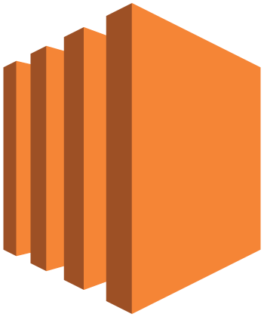
Kubernetes on AWS
3x Kubernetes masters for HA

Slide 11
Kubernetes master
API server
Controller manager
Cloud controller
Scheduler
KubeDNS
Add-ons
Notes:
The Kubernetes masters run several components within them- the API Server, which is fairly self explanatory, the controller manager, which runs various system processes for the cluster, and the scheduler, which assigns work to nodes, are some of the main ones. These are the components that allow you to interact with the Kubernetes system.
This is also where add-ons like KubeDNS and the dashboard can run.

Slide 12

Master
Master
Master
Etcd
Etcd
Etcd
Availability
Zone 1
Availability
Zone 2
Availability
Zone 3
Notes:
In addition to the Kubernetes masters, you also need to run etcd, the core persistence layer for Kubernetes. Etcd is a distributed key value store- this is where the critical data for the cluster is stored. You can optionally co-locate the masters and etcd on the same instances, so you only need to run three instances instead of six to support the control plane. This makes tradeoffs in the operational burden when upgrading your cluster, though- you have to make sure that you don’t lose quorum on etcd, or have to reboot instances… This is one of the many complexities you will encounter when standing up your own kubernetes insfrastructure.

Slide 13

Master
Master
Master
Etcd
Etcd
Etcd
Availability
Zone 1
Availability
Zone 2
Availability
Zone 3
Notes:
You then need to run the actual worker nodes- this is where your applications run. Worker nodes are generally deployed in autoscaling groups, across multiple Azs….you can choose OD or RI instances, spot instances, whatever instance type makes sense for you...

Slide 14
“Run Kubernetes for me.”

Slide 15
The EKS Tenets
A platform for enterprises to run production-grade workloads
Provides a native and upstream Kubernetes experience
Integrations are seamless, eliminate undifferentiated heavy lifting
EKS team actively contributes to the Kubernetes project

Slide 16
AWS Managed
Master
Master
Master
Customer Account
Workers
Workers
Workers
Availability
Zone 1
Availability
Zone 2
Availability
Zone 3

Slide 17
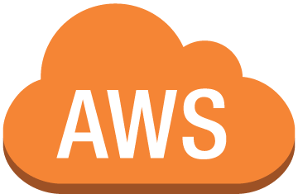
Kubectl
mycluster.eks.amazonaws.com
Availability
Zone 1
Availability
Zone 2
Availability
Zone 3

Slide 18

EKS is Kubernetes Certified

Slide 19
Kubernetes Conformance
Guaranteed Portability and Interoperability
Timely Updates
Confirmability

Slide 20
EKS
API
API
API
API

Slide 21
aws eks create-cluster –cluster-name reinvent2017 –desired-master-version 1.7 –role-arn arn:aws:iam::account-id:role/role-name

Slide 22
aws eks describe-cluster –cluster-name reinvent2017

Slide 23
Cluster Metadata
HTTP/1.1 200 Content-type: application/json
{ "cluster":
{
"clusterName": "string",
"createdAt": number,
"currentMasterVersion": "string",
"desiredMasterVersion": "string",
"masterEndpoint": "string",
"roleArn": "string",
"status": "string",
"statusMessage": "string"
}
}

Slide 24
aws eks list-clusters

Slide 25
aws eks delete-cluster –cluster-name reinvent2017

Slide 26
EKS Architecture

Slide 27




EKS Master Autoscaling

Slide 28
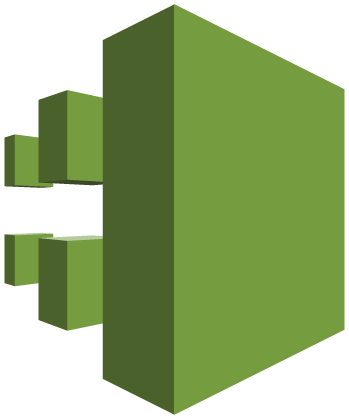

AWS CloudTrail
Amazon CloudWatch
Master

Slide 29

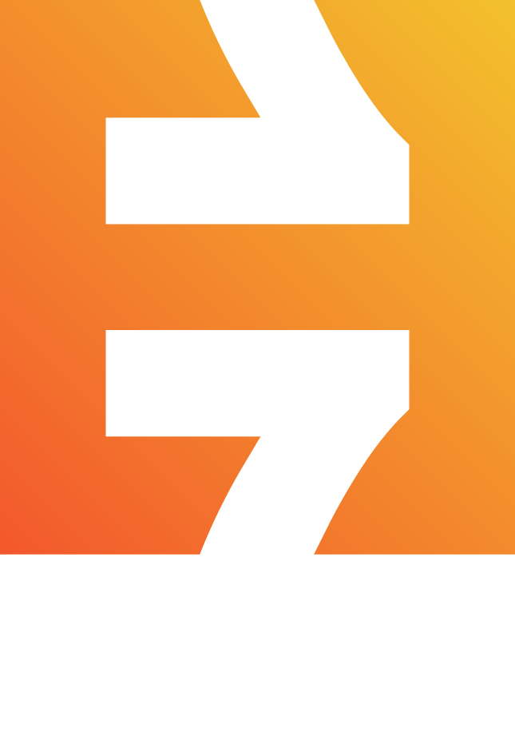
IAM Authentication + Kubectl
1) Passes AWS Identity
2) Verifies AWS Identity
Kubectl
4) K8s action allowed/denied
K8s API
AWS Auth
3) Authorizes AWS Identity with RBAC

Slide 30

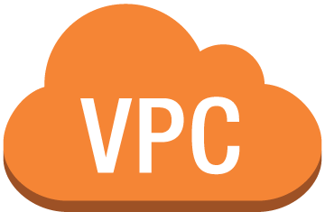
…
{
}
Native VPC networking with CNI plugin
Pods have the same VPC address inside the pod as on the VPC
Simple, secure networking
Open source and on Github
https://github.com/aws/amazon-vpc-cni-k8s

Slide 31
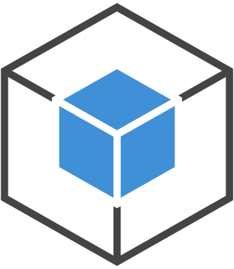

ec2.associateaddress()
ENI
Secondary IPs:
10.0.0.20
10.0.0.22
Nginx Pod
Nginx Pod
Veth IP: 10.0.0.20
Veth IP: 10.0.0.1
Secondary IPs:
10.0.0.1
10.0.0.2
Java Pod
Java Pod
Veth IP: 10.0.0.2
Veth IP: 10.0.0.22
Instance 1
ENI
Instance 2
VPC Subnet – 10.0.0.0/24

Slide 32


Kubernetes Network Policies enforce network security rules
Calico is the leading implementation of the network policy API
Open source, active development (>100 contributors)
Commercial support available from Tigera

Slide 33
Customers

Slide 34
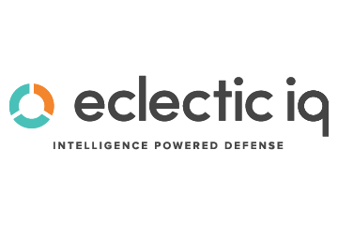
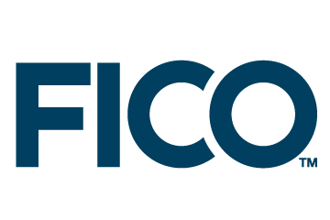
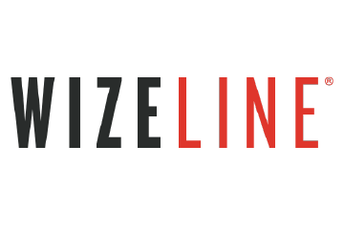
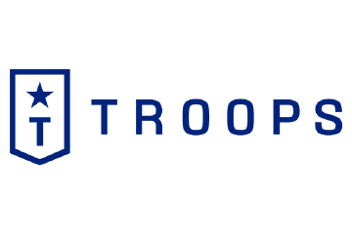
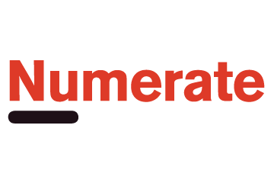
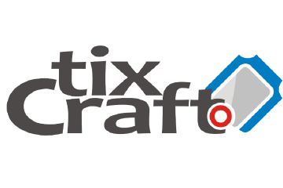

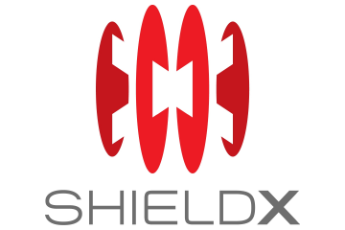
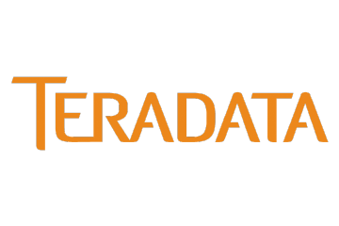
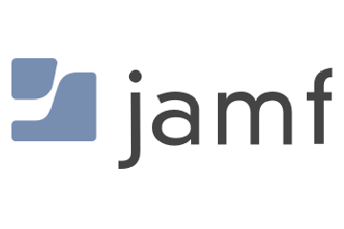
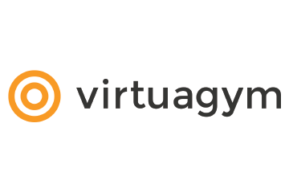

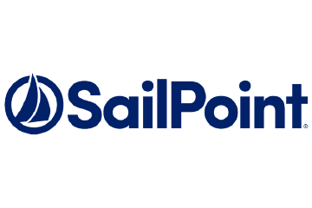

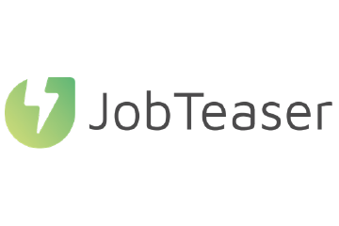
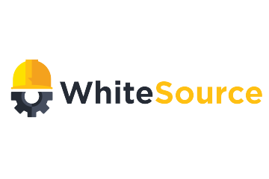
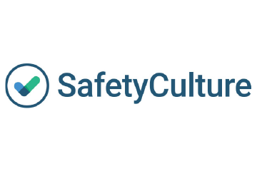
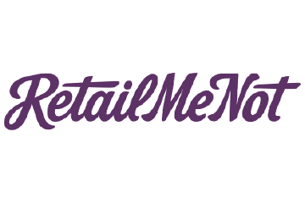
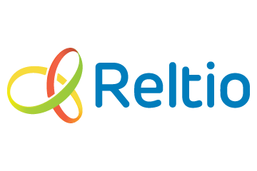
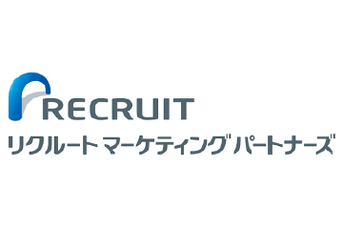
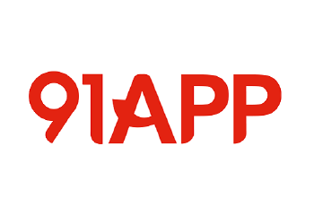
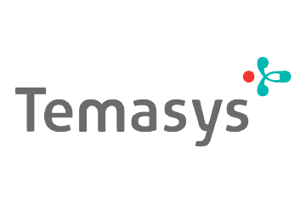

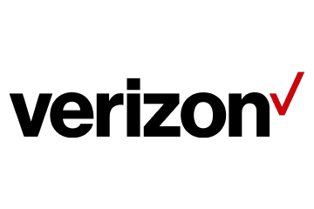
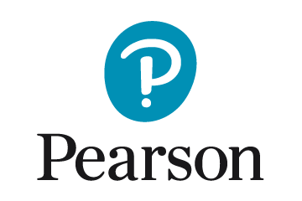
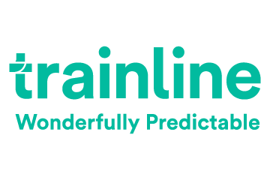
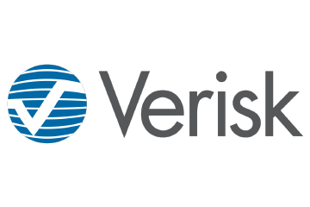

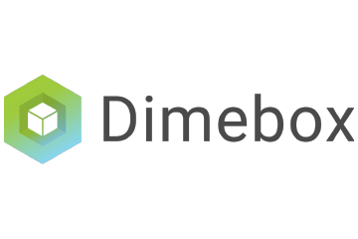
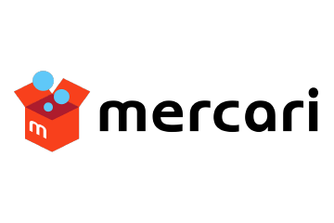
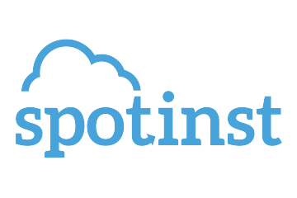
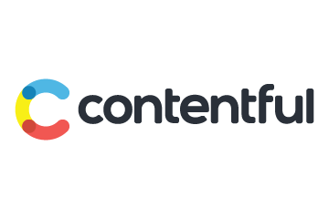
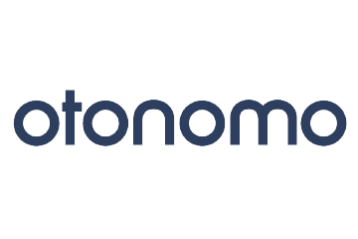

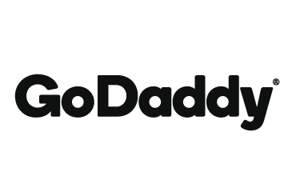

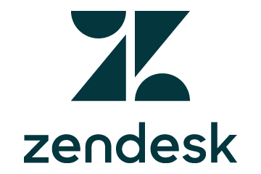
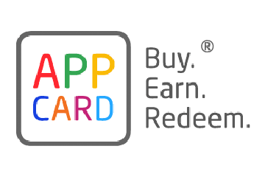
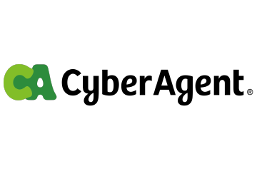


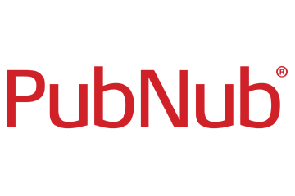
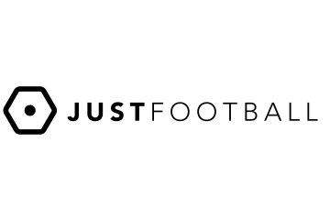
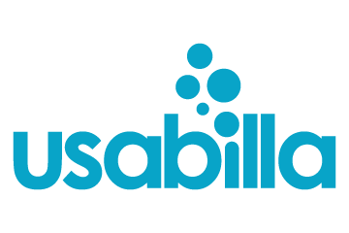

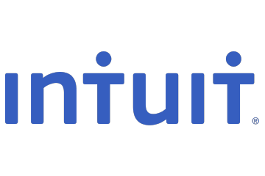
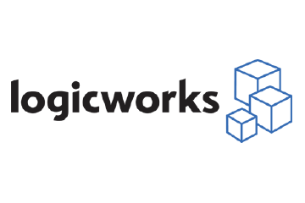
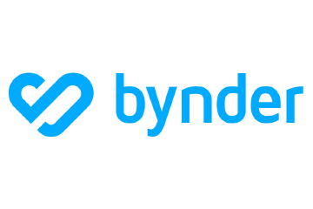
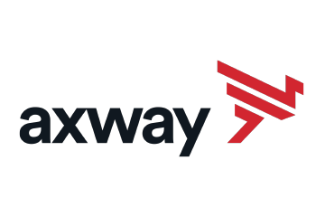
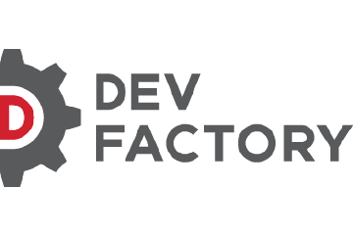
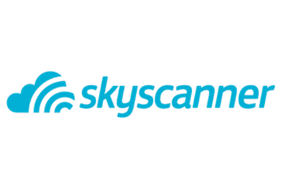
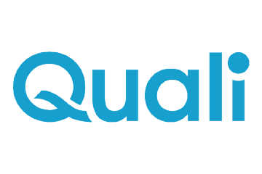

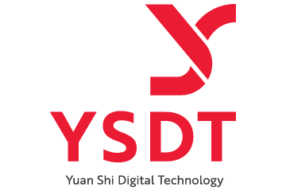
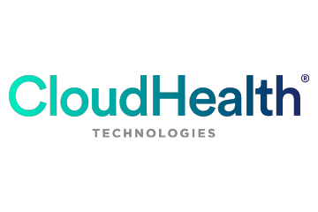





Customers Adopting Amazon EKS

Slide 35
Partners

Slide 36

























EKS Partners at Launch

Slide 37
Partner Highlight - Security
Twistlock provides full lifecycle security for applications running on EKS.
Twistlock provides the industry’s first enterprise suite for container security. Twistlock integrates with Amazon EC2 Container Registry's APIs to scan container images stored within Amazon ECR to discover vulnerabilities and misconfigurations to minimize runtime risks. Twistlock's solutions enable organizations to enforce consistent security policies across the entire container lifecycle, from development to production.

Slide 38
Partner Highlight - Security
Heptio Authenticator provides AWS IAM credentials to authenticate to a Kubernetes cluster.
Heptio was founded by two creators of the Kubernetes project to support and advance the open Kubernetes ecosystem such as Sonobouy and Ark which will help you with conformance and disaster recovery of your EKS clusters. They also partnered with AWS to build the mechanism that allows AWS Identity and Access Management to work with EKS.

Slide 39
Partner Highlight - Networking
Tigera provides network security for Amazon EKS with Project Calico, the industry standard open source implementation of Kubernetes network policy.
Project Calico, managed by Tigera, is one of the most commonly deployed network policy platforms in use in the Kubernetes ecosystem. Project Calico enables you to configured fine grain network policies for your EKS cluster. Tigera’s commercial offering – CNX, is the first secure application connectivity solution designed from the ground-up for cloud native environments, including multi-cloud deployments, that also connects and protects legacy applications running on virtual machines and bare metal hosts. CNX provides a complete packaged solution for secure application connectivity, including management, security, service mesh and networking.

Slide 40
Partner Highlight - Networking
Weaveworks WeaveCloud allows you to gain insights into your running workloads, visualize the complete architecture and provides consistent deployment workflows using the gitops methodology.
Weaveworks provides simple to use developer friendly tools so you can quickly and simply network and visualize your containerized application. Weave lets developers focus on containerized applications by taking care of connecting, observing and controlling the containerized application components in EKS.

Slide 41
Partner Highlight - DevOps
Hashicorp Terraform provides a consistent workflow for operators to provision AWS infrastructure to support Amazon EKS.
HashiCorp Vault provides a consistent approach to leverage any trusted source of identity to enforce access to systems, secrets, and applications.

Slide 42
Partner Highlight - DevOps
CloudBees CodeShip is a SaaS CI/CD solution that empowers engineering teams to practice and optimize continuous integration and delivery in the cloud for everything from simple web apps to modern microservice architectures to achieve fast, secure and frequent code delivery.
CloudBees Jenkins Enterprise integrates with Amazon EKS to give developers a CI/CD solution with the flexibility to support diverse software portfolios, embed best practices and unified governance.

